Slide 1
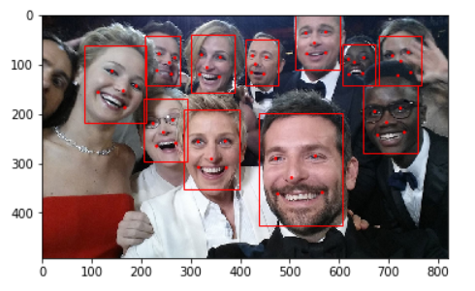

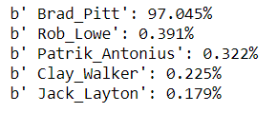
Face Recognition with Neural Networks – Tom Xu, June 2020
Multi-task Cascaded Convolutional Neural Networks(MTCNN) which is an algorithm consisting of 3 stages, which detects the bounding boxes of faces in an image along with their 5 Point Face Landmarks.
Deep models (ResNet-50 and SENet) trained on VGGFace2 by 3.31 million images of 9131 subjects, with an average of 362.6 images for each subject.

Slide 2
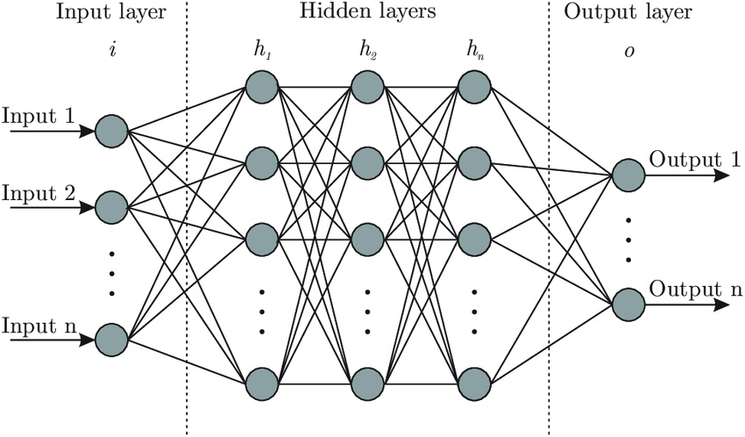
Diagram - Deep Learning Neural Networks

Slide 3
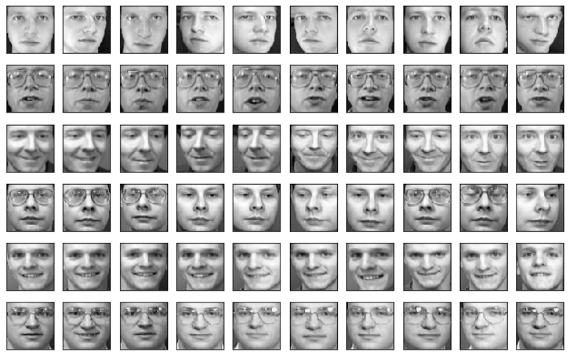
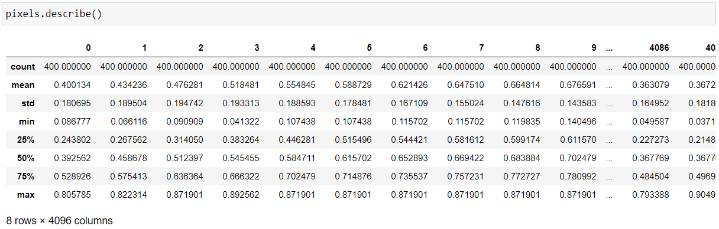
My Own Little Project: Creating Such a Deep Learning Model from Scratch
The art of neural network deep learning model combined with principal component analysis technique on analyzing the 64X64 pixel face images of 40 people with each person of 10 faces. Basic principle of embedding and encoding and projection is discussed

Slide 4
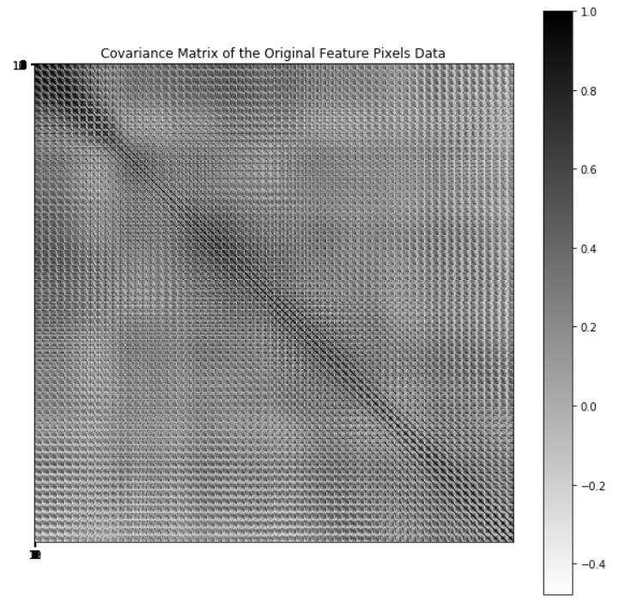
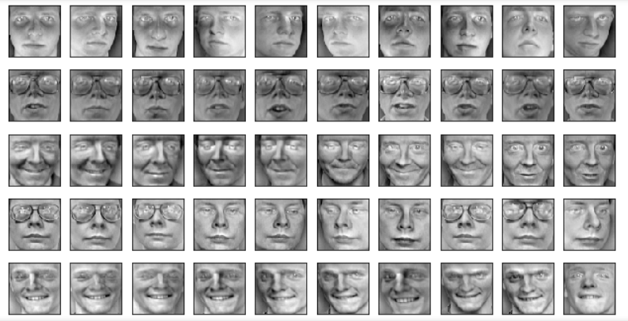
Exploratory Analysis and Standardization of the Initial Pixels Data
Strong correlations between some of the features (pixels) of the faces. And they are particularly strong around two or three cluster regions (for instance, top left region)
Standardization is the method to move the dataset to the coordinate center and set value boundaries by subtracting mean and divided by σ to give zero mean and unit variance dataset

Slide 5
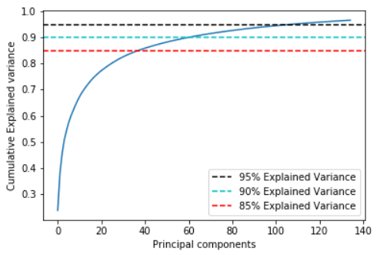
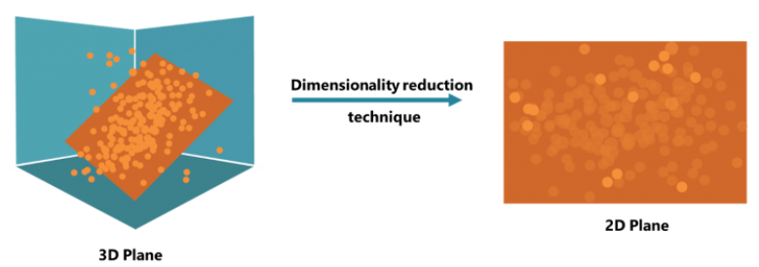
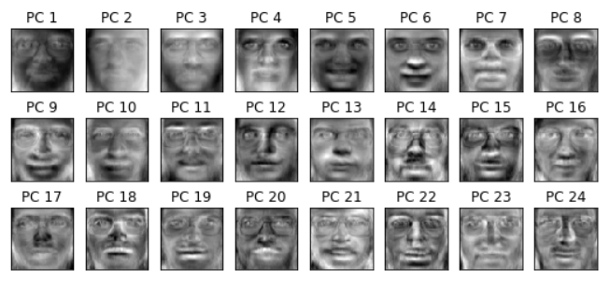
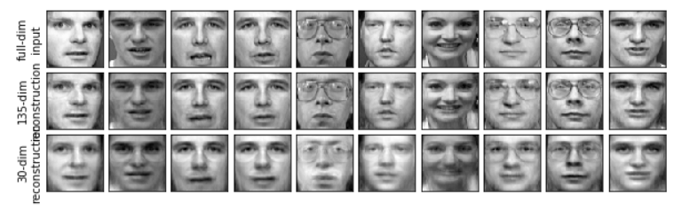
Feature Dimensional Reduction via Singular Value Decomposition (SVD) or Principal Component Analysis (PCA)

Slide 6
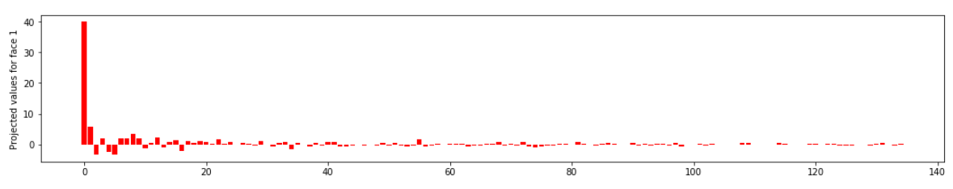
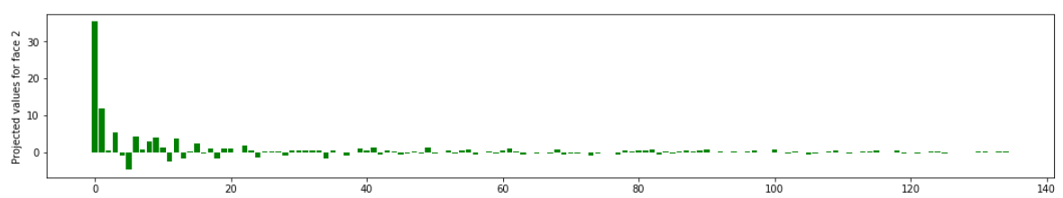
Projecting first two faces into our reduced PC space and look at their characteristics. This is the signature (fingerprint) of each face. The x-axis is the 135 principal components far left being the largest eigenvalue, y-axis are values of projection on each PC. PCA is one of embedding, encoding and projection techniques.

Slide 7
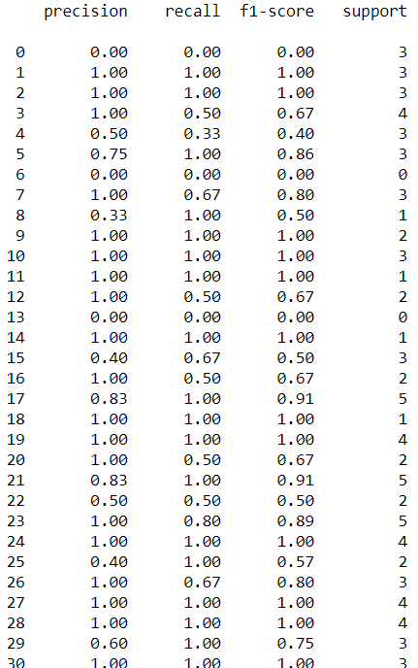
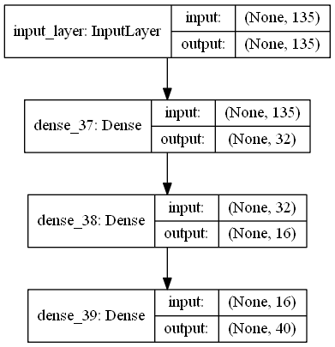
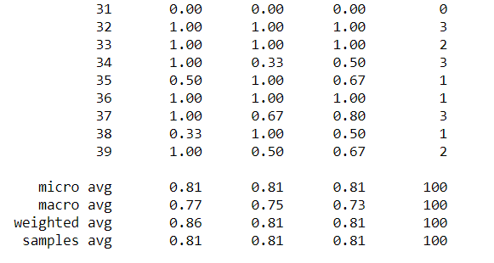
My Simple Neural Network of Four Layers, One Input Layer, One Output Layer and Two Hidden Layers in Between
ReLU is the most widely used activation function because it is nonlinear, and y=x when x>=0 and y=0 when x<0
and has the ability to not activate all the neurons at the same time. It is used for the two middle hidden layers
The output layer with 40 nodes because there are 40 output classes, 0 and 1. Use 'softmax' as the activation function for the output layer, so that the sum of the predicted values from all the neurons in the output layer adds up to one

Slide 8
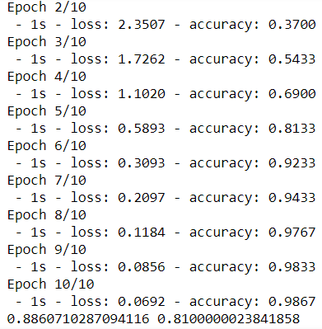
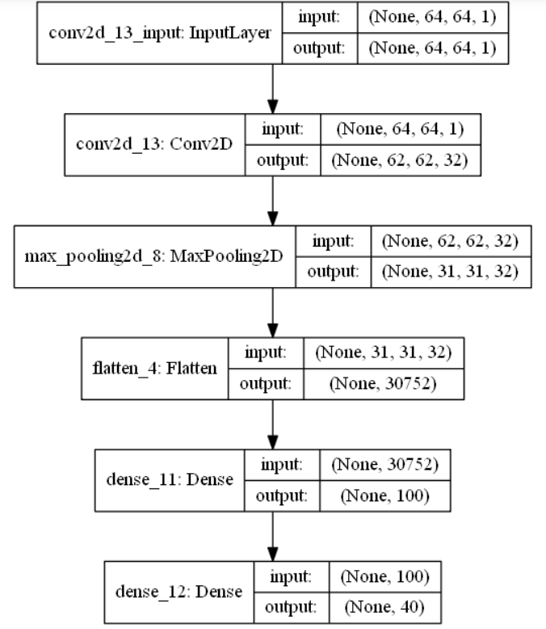
Current State of Art CNN Deep Learning Model Performance

Slide 9
My Personal Two Cents of the Neural Networks Image Analysis Process
PCA is great tool for dimensional reduction and noise filtering which is ideal for image encoding and projections. Relative smaller feature set and lower noise ratio help improve training and testing efficiency.
Key signatures of each person’s face image is the projection of his or her face pixels onto the principal components.
Simple built neural networks model and state of art convolutional neural networks model with only a few layers were demonstrated for a small set of face image data to achieve reasonable performance.
Resnet34 is a 34-layer residual network while Resnet50 has 50 layers which performs better because it is a deeper network with more parameters. New architecture search for these larger networks will require more GPU memory and takes longer and larger data set to train.
There are new development out there that add a few extra layers to the existing large network model and train with its own data which can save resources – ‘Transferred Learning’
Training on the whole set including the original large set and user’s set can be done after best learning rate had been determined.

